Slide 1




What we might see when difficulties in sensory processing occur

Slide 2

Sensory Processing
We are receiving sensory information all of the time and from all eight senses.
This information tells us all about our current world and how we should respond.
We only use about 5% of this information and either ignore or filer out the other 95%.

Slide 3
Sensory Processing Dysfunction
Difficulties can arise when we:
Filter out more than 95% of the information or
We let in more than 5% of the information
This affects our overall arousal level – our whole body’s ability to change our level of alertness.
Even small disruptions to sensory process have an impact on our function, participation and self-esteem.

Slide 4
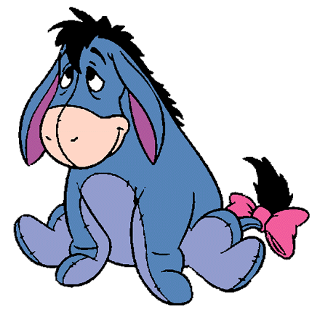


Modulation or Regulation of our Responses to Information
Under aroused
Grumpy
‘Eeyore’
Bored
Passive
Just right
Best level of alertness for the task we are doing
‘Winnie the Pooh
Over excited or overloaded
Giddy and hyper
‘Tigger’
Fear/freeze/flight/‘Piglet’/Fight

Slide 5
What we might see
Tactile
Under responsive
Drops items often
Clumsy pencil grasp
Messy dresser/eater
Unsure where their bruises came from
High pain threshold
Over responsive
Overreacts to unexpected touch
Doesn’t like grooming
Difficulty standing in line
Dislikes clothing/labels
Difficulty sitting in groups
Picky eater- strong texture and temperature preferences
Seeker
Fidgeting
Stroking
Exploring items with hands
Loves messy play

Slide 6
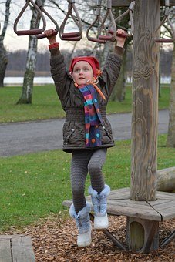
What we might see Proprioception
Under responsive
Clumsy
Bumping into things
‘all thumbs’ / ‘two left feet’
Over responsive
No neurological process or observable behaviours to support this category exists
Seeker
Banging hands/pencils on table
Rough with peers
Bumping and crashing deliberately into things
Loves rough and tumble play
Bites on stuff
Purposefully falls off things

Slide 7

What we might see
Vestibular
Under responsive
Poor balance
Reduced protective reactions to movement
Clumsy
Sedentary - prefers table top activities to sports and active play
Over responsive
Over-reacts when feet are lifted off the ground
Avoids swings
Avoids having feet elevated
Fear of steps or stairs
Motion sickness
Seeker
Bounces up and down
Constantly moving
Can’t sit still at a table or on the carpet
Spins around / rocks

Slide 8

What we might see
Visual
Under responsive
Difficulty finding something in a busy background
Struggles to locate friends in a crowd
Struggles to find their place on a page
Seeker
Looking at shiny objects
Flicking fingers
Enjoys flashing lights and colours
Over responsive
Doesn’t like bright lights
Prefers darker rooms
Covers or shades eyes
Excessive blinking or eye watering when background light changes
Wants to wear peaked caps, keeps hood up or long hair over their face

Slide 9

What we might see
Auditory
Under responsive
Not responding to instructions or name
Slow response to novel environmental sounds
Poor auditory discrimination even in low levels of background noise
Seeker
Shouting
Banging objects to make a noise
Putting music up very loud
Over responsive
Difficulty filtering out background noise
Sensitive to lawnmowers, hairdryers and vacuum cleaners
Difficulty coping in assembly, PE, lunch halls, swimming
Covers ears
Creates own noise to block external noise
Challenging behaviour in order to leave a situation

Slide 10
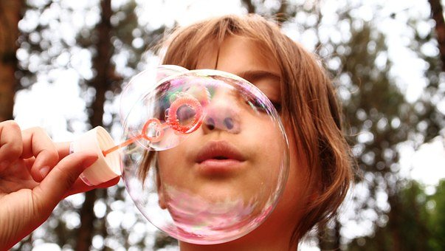
What we might see
Oral Tactile, Olfactory and Gustatory
Under responsive
May have unclear speech (language content is unaffected)
Eating difficulties
Messy eater, slow eater
Dribbling, chapped lower lip
Over responsive
Doesn’t like having teeth brushed
Picky eater-specific flavour preferences, restricted diet
Preference for bland foods or uses ketchup as a flavour masker
Gagging at strong smells
Seeker
Mouthing / biting and putting unusual things in mouth
Likes strong flavours and smells
Makes peculiar mouth movements

Slide 11
What we might see
Interoception
Under responsive
Waits until the last minute before rushing to the toilet
Struggles to toilet train with frequent accidents
Never feels hungry or thirsty
Can be very poorly and not tell you
Doesn’t stop even when exhausted
Emotions are absent or extreme
Over responsive
Frequent toilet trips
Frequent complaints of aches, pains and discomfort
Limping for longer than expected after an ankle injury has gone
Refusal to remove jacket once inside as they still feel cold
Always hungry or thirsty
Overly dramatic with a minor ailment i.e. stubbed toe/runny nose

