Slide 1



Strategies to Try at Home for your Younger Child
Children’s Therapy Department, Children’s Centre, Damers Road, Dorchester, DT1 21B 01305 254744

Slide 2
Sensory processing in younger children
Sensory experiences are vital to a child’s development. As a baby’s brain is stimulated, connections are made between brain cells, which create learning. Sensory experiences are not just about touch, vision, hearing, taste and smell. They also include vestibular (movement in space) and proprioceptive (position in space) input, as well as feedback from our internal organs (interoception).
It is important to regulate the type of sensory input a child receives, as well as to filter out excessive sensory input to prevent sensory overload.
Self-regulation is a process which enables us to alter and manage the level of alertness in our brains, so that we can appropriately deal with what is happening at that moment.

Slide 3

Touch
Touch is the most developed sense at birth.
During the neonatal period, a baby’s experience of touch moves from being either an avoidant, hypersensitive or protective response to one that is nurturing; to enable comfort, bonding and feeding.
Development of the tactile sense contributes to the development of a child’s movements.
Positive touch also enables the development of hand skills, for play and feeding.
Click here to see why your touch is great for your baby's development.

Slide 4

Tactile support strategies
Under responsive
A variety of touch activities – massage, exploring objects with hands
Contrasting tactile experiences within learning – sandpaper letters, drawing in shaving foam
Fidget toys
A good rub with a bath towel
A shower rather than a bath – a constant change in sensation.
Over responsive
Do not approach from behind
Use firm, constant pressure, not light touch
Let them control the touch and hugs
Forewarn before any activity involving touch
Avoid sitting/standing in the middle of larger groups
Position away from main thoroughfares in cafés or queues in shops.

Slide 5

Proprioception support strategies
Proprioceptive feedback through movement can also help regulate our sensory system:
Encourage crawling; set up an ‘obstacle course’ with cushions on the floor to crawl over or a pop-up tunnel to crawl through
Have rough and tumble play in a safe environment
Provide regular supervised play on a trampoline,
with an enclosure - bouncing gives lots of
proprioceptive and vestibular input
Go to the park to play on the slide or swings,
visit a soft play centre or visit the swimming pool
for movement and games in the water.

Slide 6

Proprioception support strategies continued
Other activities include:
Pushing, pulling, moving heavy objects
Carrying books or boxes around to ‘help’
Crawling activities – through a tunnel, along a bench
Stand to draw/play or lie on the floor to read
Sitting cross legged
Chairs with backs and sides
Dance sacks (lycra tubes of material)
Digging in the garden or sandpit
Dragging wet washing out of the machine
Sweeping
Sit on an exercise ball to watch television
Lots and lots of ‘heavy work’ activities with a purpose.

Slide 7
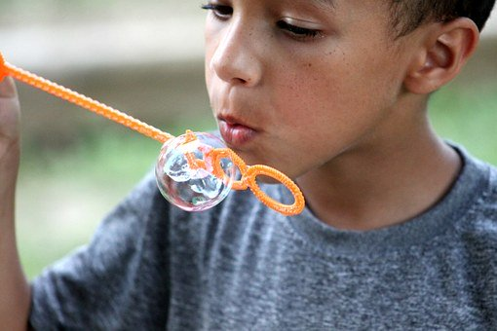
Oral support strategies
Under responsive
Strong flavoured foods
Vibration (eg: electric toothbrush)
Sucking, blowing, making noises, whistles, blowing raspberries, teething toy from the freezer, children’s party straws.
Crunchy snacks
Sour and fizzy foods
Use small sensory
activities as part of
their communication system.
Over responsive
Deep pressure to lips and palate
Chewing - a teething ring, chewy tube
Forewarn of need to touch
Build choice into essential activities with a definite end point
Use bland tasting foods
Reduce the pressure on the child to eat foods they are unsure of
Avoid strong perfumes, scented cosmetics, fabric conditioners or air fresheners
Work away from areas with food smells.

Slide 8

Vestibular support strategies
Under responsive
Structure movement activities into routine before asking them to sit still
Allow them to lean against objects when required to balance/sit down
Allow them to seek more supportive seating
Try a ‘move and sit’ cushion for table top activities
Structure movement breaks during longer seated activities
Provide activities requiring different body positions (obstacle courses are good).
Over responsive
Allow your child to control the movement
Do not force them into movement situations or environments that are scary
Use playground/park
equipment that allows their
feet to remain on or close to
the ground
Practice slow and rhythmical/predictable movements first - linear is good
Avoid fast movements before expecting them to settle
They might work better in different body orientation – for example, lying down.

Slide 9
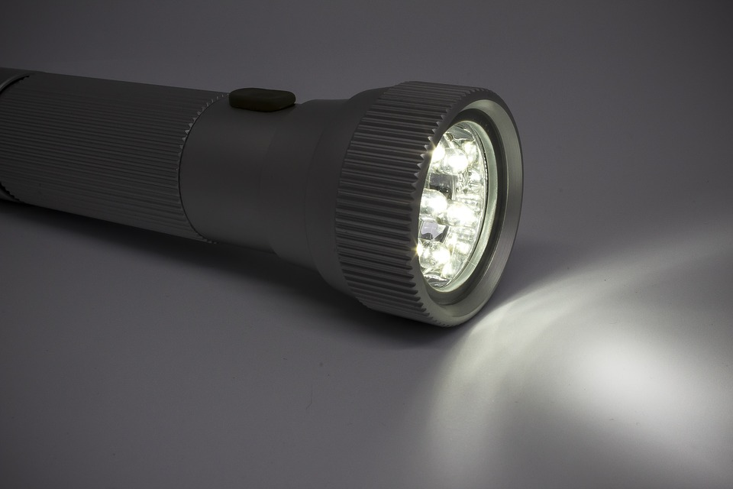
Visual support strategies
Under responsive
Remove visual clutter from their play area, to allow focused attention on required toy/book etc
Use bright colours for contrast
Provide clear boundaries or borders when mark making
Use activities with movement in them to keep stimulating the eyes
Play with a torch or ‘carnival toys’ that light, spin and flash
Use screen time – for a specific, time-managed activity.
Over responsive
Avoid fluorescent or bright lights when possible
Encourage wearing of peaked cap or hat, or children’s sunglasses
Reduce visual distractions - de-clutter.
Allow time to retreat from bright environments
Avoid flickering and flashing lights
Forewarn about bright environments.

Slide 10

Auditory support strategies
Under responsive
Give strong auditory cues - clap/bell ring
Gain eye contact before giving instructions
Ensure your child is positioned close to the sound source
Use other sensory systems to support (visual cues)
Short and clear directions - chunk information with frequent
pauses to allow
processing time
Allow individual to make
noise themselves.
Over responsive
Reduce auditory stimuli (room acoustics, echoes, background noise)
Do not talk over a distinct background noise
Make noise/speak in the visual line of the individual
Give visual instructions
Have a quiet corner or retreat
Wear child friendly headphones to minimise sound or to have background music on
Avoid going to noisy environments without supports in place
Forewarn individual of loud sound whenever possible.

Slide 11

Sleep
Children benefit from taking time to calm and settle throughout the day in order to be in a ‘just right’ state of alertness – not too over or under stimulated – in order to help them sleep at night.
There are two types of sleep - REM sleep is when your child will process their sensory experiences; Non-REM sleep enables brain development. Therefore, sleep is very important!
Having a ‘snuggle sleep object’ or blanket will give a consistent touch and smell association for sleep or nap time. Some children respond well to white noise. Ensure there are no distractions.
Try using a sleeping bag liner or baby/toddler grow bag for
bedtime to provide a more snug feeling.
Establish a sleep routine – rock to settle, not to sleep! Set up a
‘soothing sleepy space’.

Slide 12
Follow a calming bedtime routine
Each night, follow the same calming routine to help your baby/child prepare for sleep. Whenever possible, stay to the same bedtime. For example:
An hour before bed, bath your baby in warm water, perhaps with calming scented bath products
Give your baby a soothing massage before dressing
Where possible stay, within the baby’s bedroom after their bath
Read your baby a story
Give the last feed of the day in your arms, never feed your baby in the cot
Rock and sing to your baby until she is drowsy and has long tired blinks – but is not fully asleep.
Put your baby down to sleep awake but drowsy.
This can be adapted for older children, but it is important to still follow the same routine. The charity Cerebra provide a free ‘Sleep Tips’ booklet that is helpful for all children.

Slide 13
Calming strategies…
Top tips
Try swaddling young babies and wrapping toddlers – this provides a deep pressure touch input and can help settle little ones.
Add in rhythmical rocking to big hugs or cuddles to add calming movement.
Use massage regularly as part of your child’s daily routine.
Try reducing unnecessary or unhelpful sensory inputs from the environment. For example, change in a quiet place; avoid bright lights or loud music; prepare your child for changes in position and give time to respond or adjust.
Non-nutritive sucking - use a dummy for babies or try a teething ring for older toddlers. There are lots of chew toys commercially available that are safe for children to suck/chew. These provide input to the mouth and jaw which is an effective way of self soothing.

Slide 14
Calming strategies…
Top tips continued
Also use massage or deep pressure cuddles before challenging daily tasks, such as nappy change, dressing, tooth brushing etc.
Positions of flexion - ‘nested’ lying on the back, snuggled side lying or supported sitting or cradling on a lap - can help to organise our sensory system. This in turn can have a calming effect on our levels of alertness. Flexion in little ones also encourages bringing hands to midline and hands to face/mouth which is also calming.
Ensure regular naps and a consistent sleep pattern – where possible! Have a ‘sleep object’ or blanket to give snuggled sensory feedback for sleep time, as well as consistent touch and smell association. This may also help with travelling in the car if this is a challenging situation.
Incorporate any play or activity into your daily routine that increases proprioception and heavy work.

Slide 15

Other ideas to support a
‘just right’ level of regulation
Provide a den - a sheet over the table, pop-up tent or playhouse, to provide a quiet space away from the rest of the household.
Reduce overwhelming sensory inputs from the environment from the
television and/or music in order to focus on specific activities and
limit screen time.
Use music to try different rhythms and beats to see which have a positive effect on levels of alertness and which help with challenging aspects of the day.
Incorporate heavy work activity into your daily routine or play that increases proprioception.
Observe your child’s behavioural cues and work out a plan for next time!

Slide 16
Resources
https://www.nhsggc.org.uk/media/1626/making-sense-of-sensory-behaviour_falkirk-booklet.pdf This a comprehensive document with practical ideas and strategies to help make sense of sensory behaviour. It is excellent information you like/have time to read!
www.asensorylife.com contains a range of free downloadable handouts and recommended resources. Angie Voss has written the books ‘Understanding your baby’s/child’s sensory signals’.
http://www.megfaure.com ‘parenting with sense’ contains good information relevant to babies, toddlers and functional skills – play, feeding, sleep. They has also been involved in the publication of these ‘sense’ books.

