Slide 1

Weight Monitoring
West Dorset Integrated Acute and Community Dietetics Service

Slide 2

Weight Monitoring
Recommend weight monitoring at least once a year and calculate BMI
Take a look at NHS Live Well website for help with calculating BMI
For free support with making healthy lifestyle choices and reducing weight, please contact LiveWell Dorset:
- https://www.livewelldorset.co.uk/
- Freephone 0800 840 1628

Slide 3

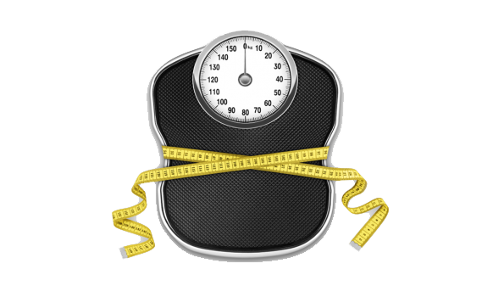
Unintentional Weight Loss
If you have noticed your weight reducing unintentionally or you have a low body weight speak with your GP who may refer you for further investigations and/or individual dietetic appointment
See The BAPEN self-screening tool to self monitor your malnutrition risk
Please complete the CDAT form and return if you have any concerns regarding weight loss

