Slide 1
Calcium and Vitamin D
West Dorset Integrated Acute and Community Dietetics Service

Slide 2
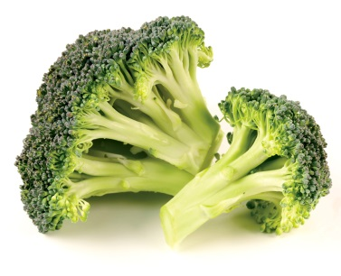
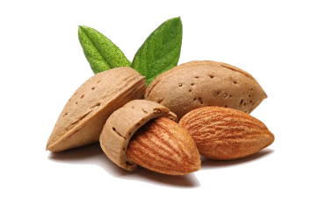
Calcium
Calcium requirements = 1000mg or more daily
Aim for three sources of dairy or dairy alternative daily
Try milk with gluten free cereal at breakfast
Serve green vegetables, such as broccoli and curly kale with your meals
Snack on dried fruit and nuts
Consider speaking with GP regarding a calcium supplement if intake from food is low

Slide 3
Vitamin D
10 μg/d (400 IU/d) of Vitamin D is recommended for the UK population aged 4 years and above
Difficult to get enough Vitamin D from diet alone, main source is from sunlight
Consider taking a 10ug Vitamin D supplement daily, particularly between September and March
If limited sun exposure, a supplement should be taken all year round

