Slide 1

Folic Acid, Vitamin B12 and Iron
West Dorset Integrated Acute and Community Dietetics Service

Slide 2
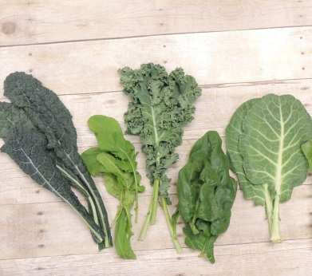
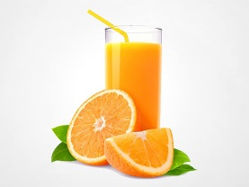
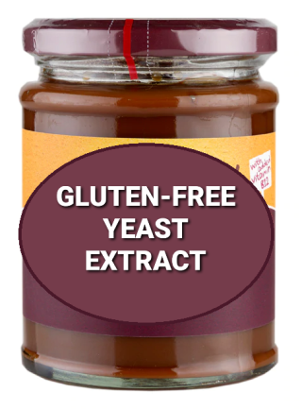
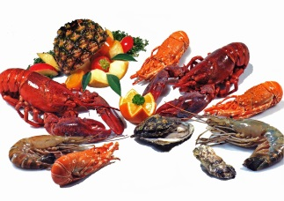
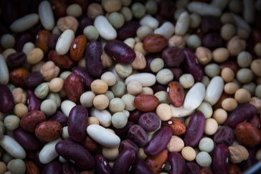
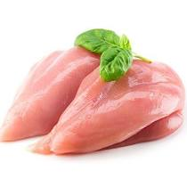
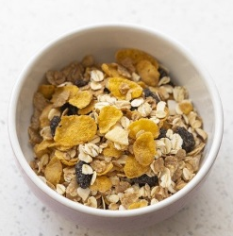
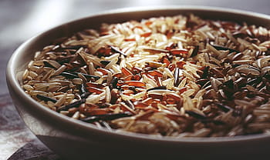
Folic Acid
With vitamin B12, needed to form red blood cells
Sources of Folic Acid
  Spinach, kale, Brussels sprouts, cabbage, broccoli
  Beans and legumes (e.g. peas, blackeye beans)
  Yeast and beef extracts (remember to pick gluten-free versions)
  Oranges and orange juice
  Whole grain foods (choose gluten-free versions)
  Poultry, pork, shellfish and liver
  Fortified foods (e.g. some brands of breakfast cereals – check the label)

Slide 3
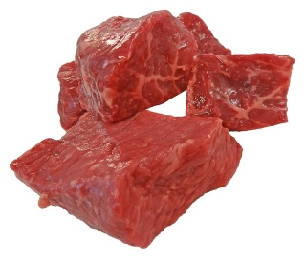
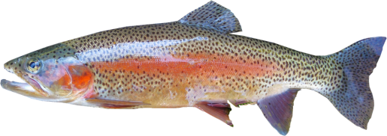
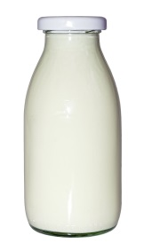
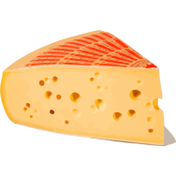
Vitamin B12
Used to reproduce DNA, make healthy blood cells and is essential for nerves to work properly.
Sources of B12
  Meat products (especially liver)
  Fish (especially shellfish and oily fish)
  Dairy products
  Fortified foods, which can include breakfast cereals, yeast extracts, soya yoghurts and non-dairy milks
If your diet doesn’t include animal products, aim for two fortified foods per day (aiming for 3mcg) or take a supplement (10mcg/day or 2000mcg/week)

Slide 4
Folic acid and B12 Deficiencies
Symptoms of deficiency: fatigue, pallor and breathlessness
Treating deficiency:
  B12 injection
  Folic Acid oral supplements

Slide 5
Iron
Mineral with many different roles, including helping oxygen transport around the body and maintaining a healthy immune system
There are two types of iron in the diet:
Haem iron (animal-based sources) most easily absorbed | Non-Haem iron (plant-based) less easily absorbed
Red meat (beef, lamb, pork) Fish Poultry Egg yolk | Green leafy vegetables Pulses and legumes (e.g. beans, peas, lentils) Tofu Nuts and seeds Dried fruit

Slide 6
Increasing Iron Absorption
Tips to optimise iron intake and absorption:
Follow a strict gluten-free diet to optimise your gut’s ability to absorb the iron in your diet
Include a source of vitamin C, such as fruit or vegetables, alongside iron-rich foods, to boost absorption
Have a source of Haem iron alongside non-Haem foods, e.g. red meat alongside vegetables, to boost the absorption of non-haem foods
Some foods can inhibit iron absorption, including tea, coffee and chocolate, so try to avoid having these with meals
There are also some foods fortified with iron, such as cereals, that can be included in your diet – look out for this on product packaging
Deficiency:
Symptoms include tiredness, pale skin, shortness of breath
You may be prescribed supplements if you are found to be iron deficient

