Slide 1

A Gluten Free Diet
Labelling, Cross Contamination and FAQs
West Dorset Integrated Acute and Community Dietetics Service

Slide 2
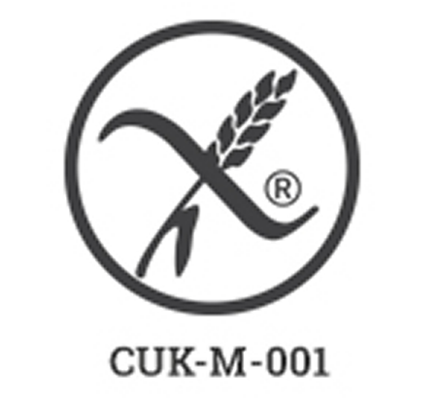
Labels
The term “gluten free” is covered by
law and means a food product
contains less than 20ppm
You may also see the crossed grain symbol to identify something as gluten-free

Slide 3
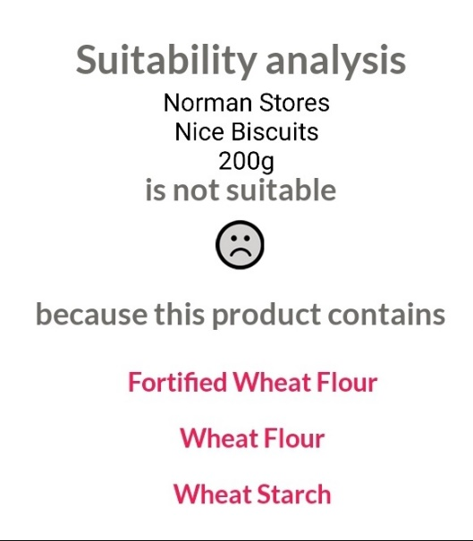
Labels
How to tell is something isn’t gluten free:
Pre-packaged food will contain a list of ingredients, with gluten-containing foods highlighted in bold:
  Gluten
  Wheat
  Rye
  Barley
  Oats
  Spelt
  khorasan wheat commercially known as Kamut®)
“May contain…”
  This is voluntary only, where the manufacturer has decided there may be a risk of cross-contamination
If you have checked the Coeliac Food and Drink Directory and it says the product contains gluten

Slide 4
Frequent Queries
Barley malt extract – depends on the quantity used as to whether gluten-free. Check labelling for “gluten free”
Yeast extract – Marmite contains slightly more than the 20ppm gluten standard, now defined by law, other brands available which are gluten free
Oats – Only oats which are uncontaminated should be eaten by people with coeliac disease. There are a very small number of people with coeliac disease who may still be sensitive to gluten-free, uncontaminated oat products

Slide 5
Cross Contamination
Keeping cooking utensils separate
Avoid frying foods within oil used for cooking foods containing gluten
Separate toaster/ toasting bags/ clean grill
Separate breadboards
Separate condiments e.g. butter, jam
Clean pots, cutlery, crockery well with warm soapy water/ dishwasher
Wipe down surfaces

