Slide 1

Prescriptions, Vaccinations and DEXA scans
West Dorset Integrated Acute and Community Dietetics Service

Slide 2

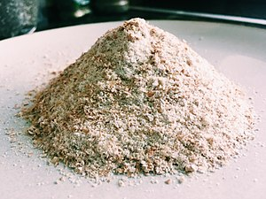
Prescriptions
Gluten-free foods with ACBS approval:
- Bread / rolls
- Flour-type mixes
Unit allowance is based on age and gender

Slide 3

Vaccinations
Influenza (Flu)
Meningococcal
Pneumococcal

Slide 4
Dual Energy X-ray Absorptiometry (DEXA) scans
A DEXA scan measures bone mineral density
Used to diagnose or assess osteoporosis risk
Assessment should be made by Consultant/ GP on an individual basis

