Slide 1



Sensory Self-care for Everyone
Using Sensations to Help
us Feel ‘Just Right’
Children’s Therapy Department, Children’s Centre, Damers Road, Dorchester, DT1 21B 01305 254744

Slide 2
Who is this module for?
This is a stand alone module for children and their parents who struggle with any illness, fatigue, disability or stress.
It is about using the senses to manage stress and low energy, to keep ourselves feeling ‘regulated’ or ‘just right.’
Aims
Understand there are 8 senses
Know how to use the senses to calm when you are stressed
Know how to use the senses to wake you up or alert you when you feel low in energy
Learn some quick strategies to help us feel ‘just right’ wherever we are
Build a sensory tool kit for our own body.

Slide 3
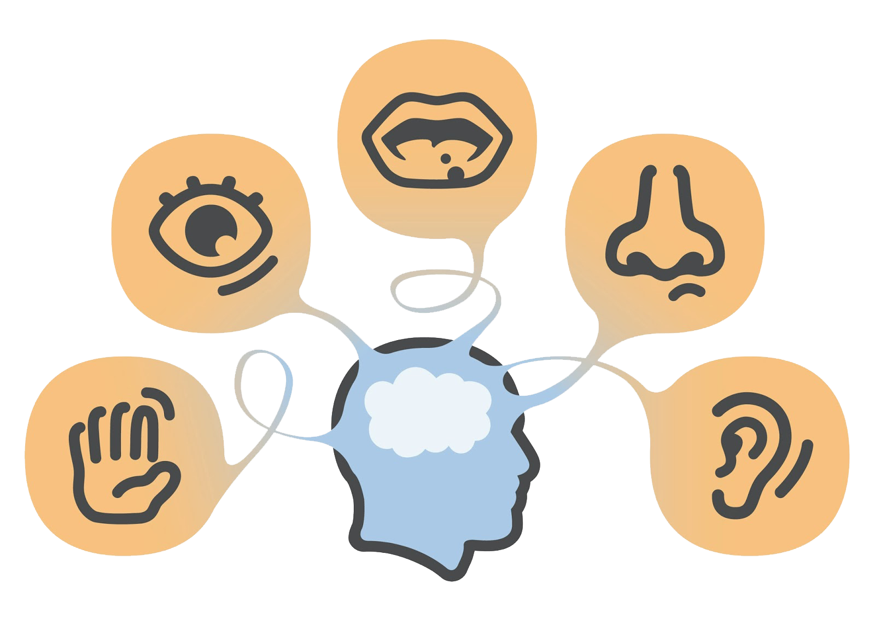
We have 5 external senses…
How we perceive and interpret the world around us
Essential to interact with the world

Slide 4
We also have 3 internal senses…
Proprioception: information from our muscles, tendons and joints help us adjust body position, apply the right amount of pressure and move smoothly.
Vestibular: our sense of head movement and balance, our position against gravity –an internal gyroscope. Posture and muscle tone depend on these signals from the inner ear.
Interoception: allows us to ‘feel’ our internal organs and skin, gives information regarding the internal state or condition of our body. The body strives constantly for balance – or homeostasis. Interoception is our internal gauge.

Slide 5
Why are senses so important?
We are receiving sensory information all the time, from all the senses. This information tells us about our current world and how we should respond.
When we are stressed, tired, ill, or emotional, our brains can become more sensitive or less sensitive to sensory information.
We can use sensations to shift how we feel: to calm us down or alert us (wake us up). This helps us be in a ‘just right’ state to manage the days demands. This is called ‘regulation.’

Slide 6
Energy states
Our brains filter differently according to our physical health, tiredness, stress and emotions. The brain is like an engine:
Overload (red zone): there is too much sensory input and it can’t cope, it goes into ‘meltdown.’ It needs as little input as possible: time and space to recover.
High energy (yellow zone): it revs high, noticing every little thing and finding it harder to filter things out – twitchy, over-sensitive! It needs CALMING.
Regulated (green zone): it revs ‘just right’ it will be able to filter between what it does and doesn’t need and cope well.
Low energy (blue zone): it revs low, finding it hard to get going – need to put your foot on the floor to make it move, or give it a tow! It needs ALERTING.

Slide 7
Energy states continued
We have a number of sayings that reflect our energy states:
Overload: ‘a whirlwind’, ‘meltdown’, ‘out of control’
High energy: ‘peel of the ceiling’, ‘high as a kite’, ‘twitchy as hell’
Regulated: ‘just right’, ‘good to go’, ‘ticking along nicely’, ‘ready to go’, ‘can take what your throw at me’
Low energy: ‘needs a rocket under him/her’, ‘just can’t get going’, ‘sluggish’, ‘peel off the floor’

Slide 8
Everyone‘s engine tends to run differently…
Overload – Can’t cope
High / over aroused
Just Right/ Optimum
Low / Under aroused
Asleep

Slide 9
Our capacity to cope with changes
Get ready for bed
Teatime
School
Breakfast
Talking
Talking
Shower
Shower
Sunlight
Sunlight
Alarm
Alarm
Tired, ill, upset, pain, big life changes.
Well rested, healthy, happy, life is consistent.

Slide 10
Sensations can help bring the body back to balance and cope with more
We often do this instinctively:
High energy:
Eat something sweet or salty when stressed
Go to our rooms and shut the door.
Low energy:
Stick loud music on to get us going
Have a shower to wake us up.
It can be helpful to be aware of these strategies and use them to help us manage daily stresses.

Slide 11
Which sensations calm and which alert?
The table on the next page lists which sensations are most calming all the way to the most alerting.
It is not the same for everyone but is a general guide to the most common experiences of sensations.
Read the table diagonally:
The top left corner are usually the most calming sensations
The bottom right corner are usually the most alerting sensations
The senses on the left side or top are generally more calming than those on the right side or bottom.
The more sensations in an activity, the more alerting it will generally be.

Slide 12
 | Taste / Smell | Oral Texture | Tactile / Touch | Movement |  | Head moving Balance | Sight | Noise
Most Calming | Sweet Vanilla | Suck Blow | Muscle activity Cool / Neutral warmth | Joint and muscle activity |  | Vertical Upright | Light / Dark colour | Vibration sounds Loud/soft
 | Salt Brine | Bite Crunch | Deep Pressure Moderate temperature | Bouncing |  | Horizontal Lying down | Walls / fences –rooms | Rhythm Music Sing song speech Rhyme
 | Sour Citrus Spice | Chew | Touch pressure Moderate temperature | Linear movement – swinging |  | Out of straight planes – diagonal | Places without walls - street | Speech sounds
Most Alerting | Bitter Smoke | Lick | Light touch Extreme temperatures | Rotary movement - spinning, turning |  | Upside down Backwards | Moving through places | Language Sentences Talking
 | Most Calming |  |  |  |  |  | Most Alerting

Slide 13
The qualities of sensations
How the sensations is delivered can affect whether it is calming or alerting. Think about the qualities of sensations and what you want to achieve.
For example:
Speed
Pressure or force
Volume
Intensity
Duration
Rhythm
Predictability
Who is in control (us, someone who knows us, a stranger).

Slide 14
Calming sensations
Calming sensations are usually:
Predictable
Rhythmical
Gentler
Repetitive
Consistent
Quieter
Being in control
Dimmer lighting
Firmer pressure
Linear movements
Ordered
Longer duration
Slower
Softer

Slide 15
Alerting sensations
Alerting sensations are usually:
Unpredictable
Not rhythmical
Stronger
Louder
Changing/variable
Tickly/light pressure
Harder
Faster
Brighter
More extreme
Multi-directional
Chaotic
In short bursts
Jerky
Not in control

Slide 16
Using sensations to feel ‘just right’
Think about your day or your child’s day. Which activities are the most alerting and most calming? What order are they in?
What could you do to change the balance of your day or their day so you feel more able to cope?
Can you build in calming activities before or after a more difficult activity?
Can you sandwich stressful or alerting activities between more calming activities?
Think about using more calming sensations before bedtime or difficult activities.
Make sure you schedule in time for doing calming activities every day. This can help ensure you have capacity to cope.

Slide 17
Some activities in particular can help us get back to ‘just right’
These activities can help whether we are low energy (blue zone) or high energy (yellow/red zone):
Movement
Deep or slow breathing
Deep pressure touch
Using our mouths

Slide 18
1. Movement
Movement of the body will calm or alert, whatever is needed. It is a great way to regulate our system and get to ‘just right’.
The same movement strategies may be used for being in a low energy blue state or a high energy yellow state.
Incorporate movement activities they enjoy into your / their routine.
Be guided by your / their interests.
Make sure the movement is not complex or challenging, it needs to be just right in order for it to organise our brain.
Movement also helps us build stamina, core stability and strength for postural control. It helps us sleep well at night.

Slide 19
1. Movement
Ways to move
Regular exercise classes or clubs
Run, cycle or walk to and from friends' houses, school, shops
Dancing
Help with the gardening or DIY projects
Carry heavy bags
Help with the housework: hoover, mop, sweep
Skateboarding or scooting
Yoga / Pilates / aerial yoga if you like upside down
Swimming
Online movement activities – YouTube, Cosmic Kids Yoga
Wii Fit or similar
Push yourself up in the chair using your arms, or press you bottom and back really hard into the chair. Or push your hands or body hard into a wall.

Slide 20
2. Deep or slow breathing
We often sigh when we are high or low energy. This helps us to regulate or organise and calm our brains.
Breathing slowly and deeply, using all of your lungs reduces stress hormones in our body.
Take time to notice how you breathe. Search breathing exercise ideas online and choose the ones you like best.
Breathing in for longer than you breathe out is generally more alerting.
Breathing out for longer than you breathe in is generally more calming.
You can also trace around your fingers as you breathe: up when you breathe in, down when you breathe out.

Slide 21
2. Deep or slow breathing
Some breathing ideas
Hold the hands on the tummy. Breathe in for a count of four to the chest and tummy causing the hands to rise
Breathe out for a count of four, the hands will come back down
You can adjust the timings
You can hold the breath between breathing in and out for a count of two if you prefer. This is called square breathing
There is also triangle and star breathing. Chose the one which you like best. See the diagrams below
Breathing in for longer than you breathe out is generally more alerting
Breathing out for longer than you breathe in is generally more calming.
Breathe In
Out
In
In
Out
Hold
Breathe In
Hold

Slide 22
3. Deep pressure touch
This can be organising for the brain. You or your child can use it by:
Ask for a firm hug or give yourself one
Try a weighted blanket, lap pad, vest, or wear a tight compression vest or sleeping under a compression sheet (a giant Lycra tube inserted over the mattress)
Have a warm bath
Squeeze yourself into a small space or on a bean bag
Curl into a ball
Using a vibrating cushion or tube, like a massage cushtie.
Search online for vibrating, weighted and compression items. Always follow manufacturer guidelines. Vibration tends to be a love or hate sensation.

Slide 23
4. Using our mouths
The mouth is one of our most used tools for regulating ourselves, but we often unaware of it. Everyone uses it in a different way at different times, but common strategies are:
Chewing or biting: sweets, nails, pen lids, cheeks, hair, lips, chewing gum, clothes
Sucking: sweets, fingers, clothing, pens, sports bottles
Taking frequent sips of a drink
Having very hot or cold drinks or foods
Eating crunchy foods or foods we can pull on
Playing with our mouths or tongue
Holding the mouth open
Grinding our teeth
Singing, humming, whistling, or making repetitive noises.

Slide 24
4. Using our mouths
Tools to use
Often calming and organising:
Use a drinks bottle with a straw or bite and suck mechanism
Put sweet or salty, crunchy or chewy foods in your snack box, apples, carrots, celery, peanuts, crackers, crisps
Blow bubbles or instruments
Suck a thicker drink (milkshake or smoothie), or a lollipop
Get a chew tip for your pencil or some chewable jewelry (see www.tinknstink.com)
Sing, whistle, or hum.
Often more alerting:
Put ice in your drinks
Eat very hot or very cold foods
Sour or fizzy sweets
Popping candy.

Slide 25
Other sensory ideas for regulation
On the following slides are some ideas for how to use the other sensations to either calm or alert.
These are just a general guide, everyone is different.
Notice how the different sensations affect you so you know what calms you and what wakes your brain up.
Don’t forget the quality of a sensation can also make it calming or alerting – for example rhythmic touch compared to unpredictable touch.

Slide 26
Touch
Often calming and organising:
Being warned before touch
Use firm, deep pressure touch
Softer, natural fabrics
Wearing familiar clothes
Heavy clothes or wrapping yourself in a blanket
Make sure there are not items that will brush against you in environment – for example, plants, mobiles
Rhythmical touch, stroking
Hugs
Often more alerting:
Light tickly touch
Tickling
Rubbing your skin with scratchy textures
Lots of textures to feel and play with
Lots of messy play – sand, jelly, dirt
Holding items in the palm
Using very cold cutlery
Going barefoot
Wearing lots of different textures.

Slide 27
Taste and smell
Often calming and organising:
Warm food and drink
Sweet or salty tastes
Plainer or blander foods
Favourite foods
Flowery, vanilla or sweet smells – think of your toiletries and cleaning fluids
Keeping tastes and smells to a minimum
Keeping tastes separate.
Often more alerting:
Stronger, spicy, bitter, smoky, sour, tart foods
Lots of different tastes
Very hot or very cold food and drink
Strong smells, citrus, smoky, woody
Lots of smells
Use lots of different tastes and smells
Mixing smells and tastes.

Slide 28
Sight
Often calming and organising:
Pastel colours
Plain walls
Not too many contrasting colours
Dimming the light or wearing a cap, sunglasses, hood
Being outdoors, nature
Repetitive patterns – lava lamp, video games, fish tank, open fire
Familiar pictures or videos.
Often more alerting:
Lots of different pictures, colours on walls, patterned wallpaper
Bright or fluorescent light
Sunlight
Patterned clothes
Lots of clashing colours
Lots to look at in a room
Flashing or rapidly alternating light
Being indoors.

Slide 29
Sound
Often calming and organising:
Nature sounds
Quiet, rhythmical and gentle sounds
Slower paced music
Reduce background noise using headphones or drown it out with music
Keeping your voice quiet and at the same tone and pace
You own noise.
Often more alerting:
Manmade sounds – hand dryers, humming fridges
Lots of background noise - television, radio, machinery, roads
Loud, unpredictable sounds
Shouting or screaming
High pitched, shrill, uneven voices
Sudden unexpected noises – loud bangs
Other people’s noises.

Slide 30
Vestibular
Often calming and organising:
Linear movement: rocking forwards and backwards or side to side
Gentle movements
Gentle swinging
Repetitive head movement
Sitting or lying down
Being warned before movement
Often more alerting:
Large movements
Spinning, whirling
Lots of twists and turns
Upside down
Bumping: car rides, horse rides
Jumping
Climbing up high
Shaking head
Head butting
Going fast – bike, car
Braking

Slide 31
Resources
Williams, MS. & Shellenberger, S. (1996) How does your engine run? The Alert Program for self-regulation. TherapyWorks, Inc.
Dunn, W. (2009). Living Sensationally. Jessica Kingsley Publishers.
Kupyers, L. (2011). The Zones of Regulation. A curriculum designed to foster self-regulation and emotional control. Think Social Publishing Inc.
If you think your child may avoid or seek out certain sensations more than other children, please see our other modules on sensory processing problems.

